Slide 1

Project Title: Robotic Arm
Names:T.Kalyan (21KD5A0318)
Project Guide:G.Ravi
Year & Sem : IV – I

Slide 2
ROBOTIC ARM

Slide 3
INTRODUCTION OF NX10 SOFTWARE:
NX10 is a CAD/CAM/CAE software product developed by Siemens PLM Software.
It is a comprehensive product development solution that spans the entire product lifecycle.
NX10 includes features for 3D modeling, simulation, manufacturing, and analysis.
It is used by a wide range of industries, including automotive, aerospace, and manufacturing.
NX10 is a powerful and versatile software that can help companies to improve their product development processes.
Some of the key features of NX10 include:
Feature-based parametric modeling
Synchronous technology
Advanced simulation capabilities
Integrated manufacturing tools
CAE analysis
NX10 is a complex software, but it is easy to learn and use.
There are a variety of resources available to help users learn NX10, including online tutorials, documentation, and training courses.

Slide 4
WHO USES NX10?
Companies of all sizes in a variety of industries
Automotive
Aerospace
Manufacturing
Medical
Consumer products

Slide 5
KEY FEATURES OF NX10:
Feature-based parametric modeling
Synchronous technology
Advanced simulation capabilities
Integrated manufacturing tools
CAE analysis

Slide 6
BENIFITS OF USING NX10:
Improve product quality by reducing errors and improving the design process
Reduce costs by streamlining the manufacturing process
Shorten development cycles by providing a single platform for all product development activities

Slide 7
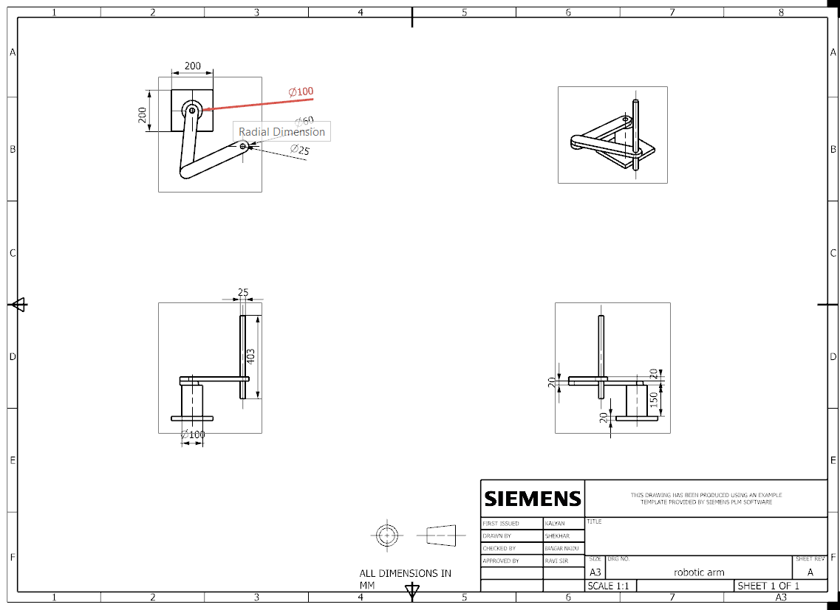
DRAFTING:

Slide 8
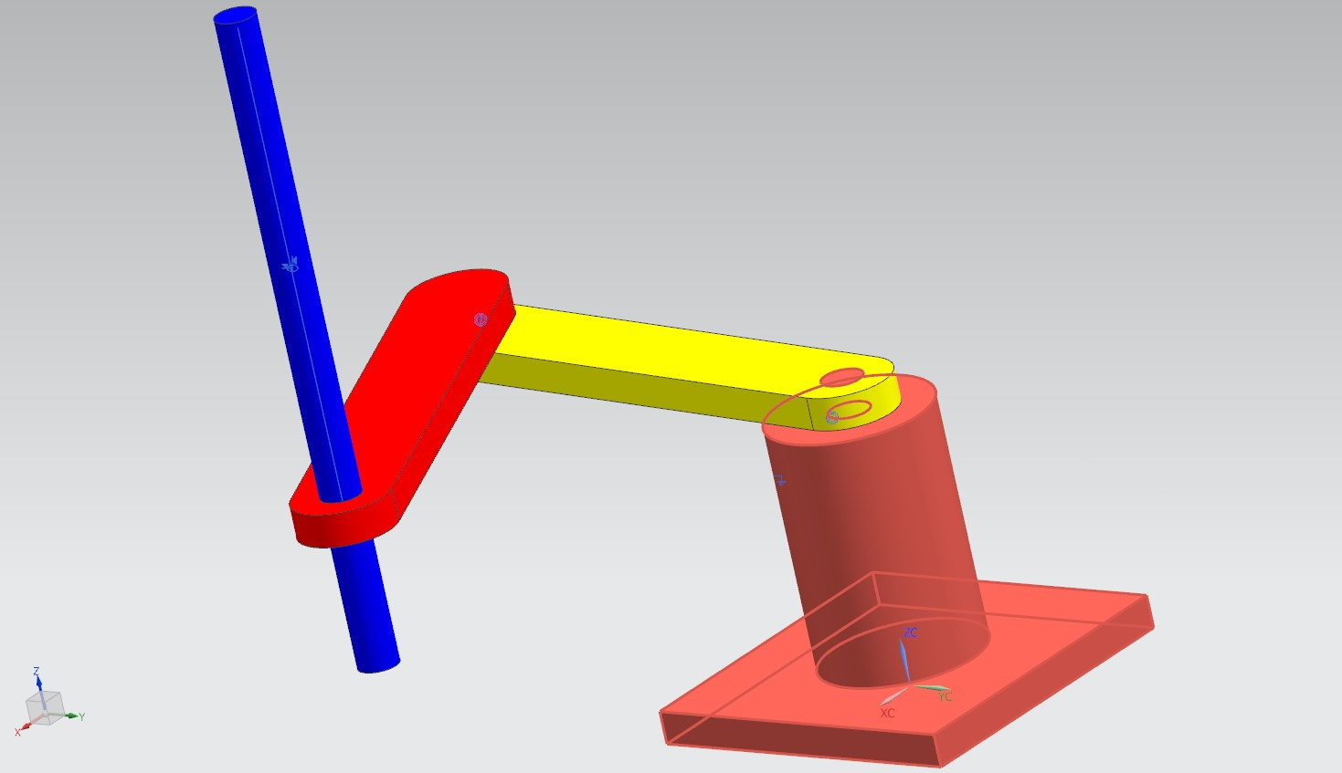
WHAT IS ROBOTIC ARM?
A robotic arm is a type of robot that is designed to have the same movements as a human arm. It is typically made up of a series of links and joints that are connected by actuators. The actuators are responsible for moving the links, which allows the arm to perform a variety of tasks.

Slide 9
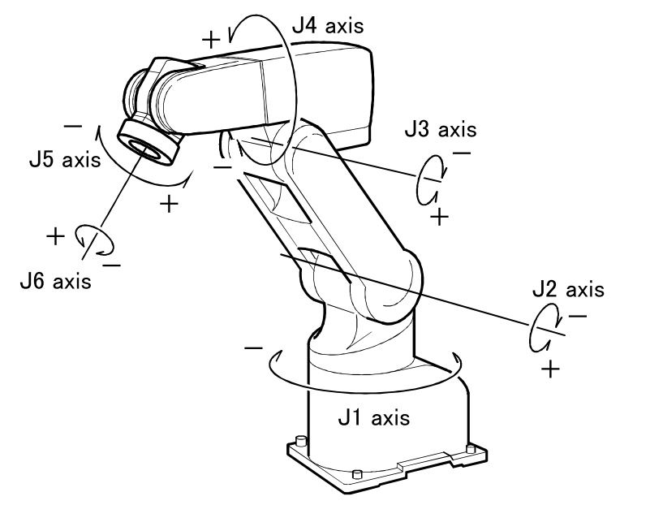
WORKING PRINCIPLE OF A ROBOTIC ARM:
The principle of a robotic arm is to use a series of joints to move an end effector (such as a gripper or welding torch) through space. The joints are typically rotary joints, and the number of joints determines the degree of freedom of the arm. A robotic arm with six joints has six degrees of freedom, which means it can move in six different directions.
The joints are powered by motors, which are controlled by a computer. The computer sends signals to the motors, which then rotate the joints. The computer can calculate the exact position of the end effector by knowing the position of each joint.

Slide 10
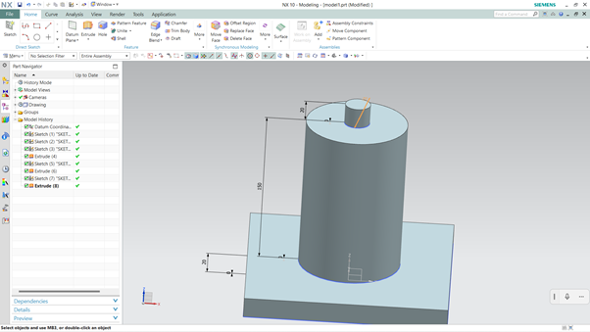
MODEL 1:
Steps to create model 1:
Step 1: Take a new file and select model and name it as model 1 and choose the location and click ok
Step 2: Now take a rectangle 200*200 and extrude it to the 20mm
Step 3: Take a circle with diameter of 100mm on the centre of rectangle and extrude it to the 150mm
Step 4: Now take another circle on the 100mm circle with diameter of 25mm with 20mm depth.
Step 5: Save the model

Slide 11
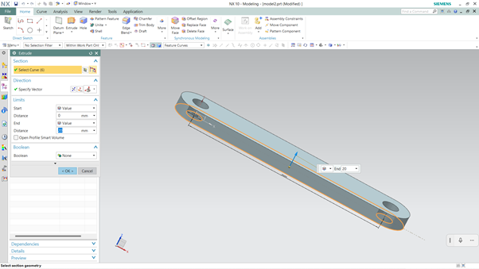
MODEL 2:
Steps to create model 2:
Step 1: Take a new file and select model and name it as model 2 and choose the location and click ok
Step 2: Take a rectangle 300*60 and extrude it to the 20mm.
Step 3: Draw a arc at both ends of a circle with radius of 30mm and extrude it to the 20mm
Step 4: Now take circles on the rectangle with distance of 300mm on the rectangle with diameter of 25mm of circles and kept those as holes on rectangle by extrude
Step 5: Save the model

Slide 12
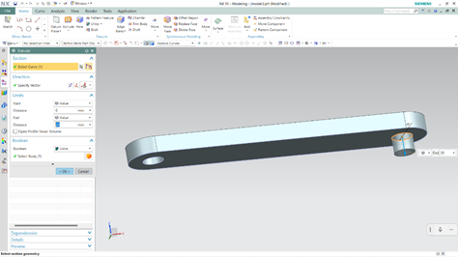
MODEL 3:
Steps to create model 3:
Step 1: Take a new file and select model and name it as model 3 and choose the location and click ok.
Step 2: Take a rectangle 300*60 and extrude it to the 20mm.
Step 3: Draw a arc at both ends of a circle with radius of 30mm and extrude it to the 20mm
Step 4: Now take circles on the rectangle with distance of 300mm on the rectangle with diameter of 25mm of circle at one end and kept that as hole on rectangle by extrude-> subtraction. On the other end extrude it to the 20mm.
Step 5: Save the model

Slide 13
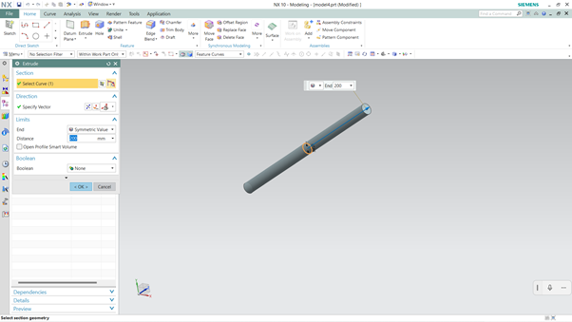
MODEL 4:
Steps to create model 4:
Step 1: Take a new file and select model and name it as model 4 and choose the location and click ok.
Step 2: Draw a circle with radius of 12.5mm and extrude it to the 400mm.
Step 3: Save the model

Slide 14
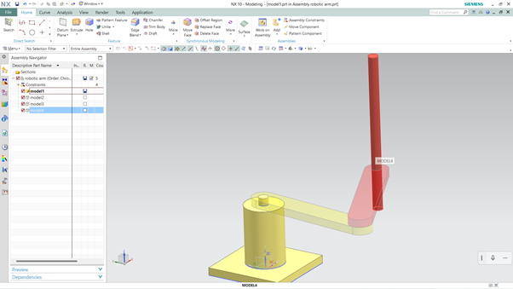
ASSEMBLE THE COMPONENTS:
Steps for making the assembly of components:
Step 1: Take a new file and select Assemblies and name it as Robotic arm and choose the location and click ok
Step 2: Set model 1 component as base and fix it.
Step 3: Add model 2 component and concentric one end of the hole of the model 2 to the extrude part of the model 1 which is 25mm.
Step 4: Add model 3 and concentric the extruded part of model 3 to the model 2
Step 5: Add model 4 and use the touch aline and concentric to insert into the hole of the model 3.
Step 6: Save the model

Slide 15
ADVANTAGES OF ROBOTIC ARM:
Precision and accuracy: Robotic arms can be programmed to perform tasks with a high degree of precision and accuracy. This is especially important in applications where the slightest deviation could result in damage or injury.
Repeatability: Robotic arms can repeat the same task over and over again with the same level of precision and accuracy. This is important in applications where consistency is critical, such as manufacturing and assembly.
Speed: Robotic arms can operate much faster than humans, which can improve productivity and efficiency.
Safety: Robotic arms can be designed to operate in hazardous environments, such as those with high temperatures or radiation levels. This can help to protect human workers from injury.
Flexibility: Robotic arms can be programmed to perform a wide variety of tasks. This makes them a versatile tool that can be used in a wide range of applications.

Slide 16
DISADVANTAGES OF ROBOTIC ARM:
High initial cost: Robotic arms are expensive to purchase and install. This can be a barrier for some businesses, especially small businesses.
Complexity: Robotic arms are complex machines. They require specialized knowledge and skills to program and maintain. This can be a challenge for businesses that do not have the in-house expertise.
Limited flexibility: Robotic arms are typically designed to perform a specific task. This can limit their flexibility in a business environment where tasks are constantly changing.
Safety concerns: Robotic arms can be dangerous if they are not properly programmed or maintained. This can lead to injuries to workers or damage to property.
Job displacement: As robotic arms become more common, they could displace some human workers. This could lead to unemployment and social problems.

Slide 17
APPLICATIONS OF ROBOTIC ARM

Slide 18
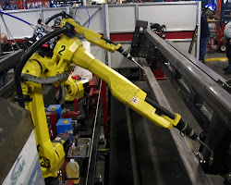
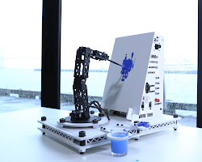
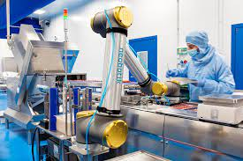
MANUFACTURING SECTOR:

Slide 19
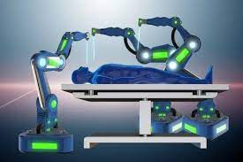
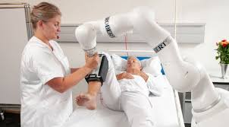
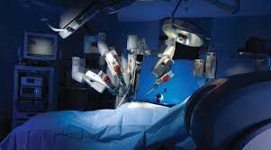
HEALTHCARE SECTOR:

Slide 20

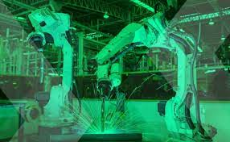
UNDERWATER APPLICATIONS
WELDING

Slide 21
CONCLUSION:
NX10 is a powerful and versatile software that can help companies to improve their product development processes.
It is a valuable tool for companies of all sizes in a variety of industries.

Slide 22
THANK YOU

